Slide 1
Trees
Chapter 6

Slide 2
Chapter Objectives
To learn how to
use a tree to represent a hierarchical organization of information
use recursion to process trees
implement binary trees, binary search trees, and heaps using linked data structures and arrays
To understand
the different ways of traversing a tree
the differences between binary trees, binary search trees, and heaps

Slide 3
Chapter Objectives (cont.)
To learn how to
use a binary search tree to store information so that it can be retrieved in an efficient manner
use a Huffman tree to encode characters using fewer bytes than ASCII or Unicode, resulting in smaller files and reduced storage requirements

Slide 4
Trees - Introduction
All previous data organizations we've studied are linear — each element can have only one predecessor and successor
Accessing all elements in a linear sequence is O(n)
Trees are nonlinear and hierarchical
Tree nodes can have multiple successors (children), but only one predecessor or parent

Slide 5
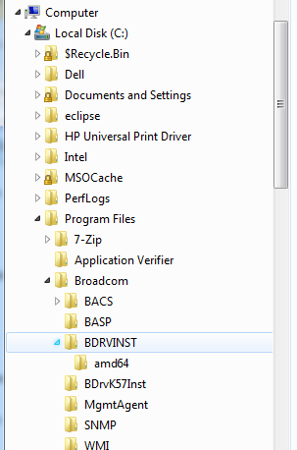
Where Have I Seen Trees?

Slide 6
Trees - Introduction (cont.)
Trees can represent hierarchical organizations of information:
class hierarchy
disk directory and subdirectories
family tree
Trees are recursive data structures
Why?
Many methods to process trees are written recursively

Slide 7
Trees - Introduction (cont.)
We cover only binary trees
In a binary tree each element has two successors
Binary trees can be represented by arrays and by linked data structures
Searching a binary search tree, an ordered tree, is generally more efficient than searching an ordered list—O(log n) versus O(n)

Slide 8
Job Interview Questions
First explain what a tree, then binary tree, then a binary search tree is. Implement a function that verifies whether a binary tree is a valid binary search tree.
Find the deepest common ancestor of two nodes in a tree structure.
Define binary search tree. Develop a procedure to verify a binary search tree.
Find the height of a binary tree
Find the max depth of a binary tree
Write a function that takes 2 arguments: a binary tree and an integer n, it should return the n-th element in the inorder traversal of the binary tree.

Slide 9
Job Interview Questions
Convert a binary search tree to a sorted double-linked list. We can only change the target of pointers, but cannot create any new nodes.
Write an algorithm to travere a binary tree level wise.

Slide 10
Tree Terminology and Applications

Slide 11
Tree Terminology
A tree consists of a collection of elements or nodes, with each node linked to its successors
dog
cat
wolf
canine

Slide 12
Tree Terminology (cont.)
A tree consists of a collection of elements or nodes, with each node linked to its successors
The node at the top of a tree is called its root
dog
cat
wolf
canine

Slide 13
Tree Terminology (cont.)
A tree consists of a collection of elements or nodes, with each node linked to its successors
The links from a node to its successors are called branches
dog
cat
wolf
canine

Slide 14
Tree Terminology (cont.)
A tree consists of a collection of elements or nodes, with each node linked to its successors
The successors of a node are called its children
dog
cat
wolf
canine

Slide 15
Tree Terminology (cont.)
A tree consists of a collection of elements or nodes, with each node linked to its successors
dog
The predecessor of a node is called its parent
cat
wolf
canine

Slide 16
Tree Terminology (cont.)
A tree consists of a collection of elements or nodes, with each node linked to its successors
Each node in a tree has exactly one parent except for the root node, which has no parent
dog
cat
wolf
canine

Slide 17
Tree Terminology (cont.)
A tree consists of a collection of elements or nodes, with each node linked to its successors
Nodes that have the same parent are siblings
dog
cat
wolf
canine

Slide 18
Tree Terminology (cont.)
A tree consists of a collection of elements or nodes, with each node linked to its successors
A node that has no children is called a leaf node
dog
cat
wolf
canine

Slide 19
Tree Terminology (cont.)
A tree consists of a collection of elements or nodes, with each node linked to its successors
Leaf nodes also are known as external nodes, and nonleaf nodes are known as internal nodes
A node that has no children is called a leaf node
dog
cat
wolf
canine

Slide 20
Tree Terminology (cont.)
A tree consists of a collection of elements or nodes, with each node linked to its successors
dog
cat
wolf
canine
A generalization of the parent-child relationship is the ancestor-descendant relationship

Slide 21
Tree Terminology (cont.)
A tree consists of a collection of elements or nodes, with each node linked to its successors
dog is the parent of cat in this tree
dog
cat
wolf
canine
A generalization of the parent-child relationship is the ancestor-descendant relationship

Slide 22
Tree Terminology (cont.)
A tree consists of a collection of elements or nodes, with each node linked to its successors
cat is the parent of canine in this tree
dog
cat
wolf
canine
A generalization of the parent-child relationship is the ancestor-descendant relationship

Slide 23
Tree Terminology (cont.)
A tree consists of a collection of elements or nodes, with each node linked to its successors
dog
canine is a descendant of cat in this tree
cat
wolf
canine
A generalization of the parent-child relationship is the ancestor-descendant relationship

Slide 24
Tree Terminology (cont.)
A tree consists of a collection of elements or nodes, with each node linked to its successors
dog is an ancestor of canine in this tree
dog
cat
wolf
canine
A generalization of the parent-child relationship is the ancestor-descendant relationship

Slide 25
Tree Terminology (cont.)
A tree consists of a collection of elements or nodes, with each node linked to its successors
dog
cat
wolf
canine
A subtree of a node is a tree whose root is a child of that node

Slide 26
Tree Terminology (cont.)
A tree consists of a collection of elements or nodes, with each node linked to its successors
dog
cat
wolf
canine
A subtree of a node is a tree whose root is a child of that node

Slide 27
Tree Terminology (cont.)
A tree consists of a collection of elements or nodes, with each node linked to its successors
dog
cat
wolf
canine
A subtree of a node is a tree whose root is a child of that node

Slide 28
Tree Terminology (cont.)
A tree consists of a collection of elements or nodes, with each node linked to its successors
The level of a node is determined by its distance from the root
dog
cat
wolf
canine

Slide 29
Tree Terminology (cont.)
A tree consists of a collection of elements or nodes, with each node linked to its successors
The level of a node is its distance from the root plus 1
Level 1
dog
Level 2
cat
wolf
Level 3
canine

Slide 30
Tree Terminology (cont.)
A tree consists of a collection of elements or nodes, with each node linked to its successors
Level 1
dog
The level of a node is defined recursively
Level 2
cat
wolf
Level 3
canine

Slide 31
Tree Terminology (cont.)
A tree consists of a collection of elements or nodes, with each node linked to its successors
Level 1
dog
The level of a node is defined recursively
Level 2
cat
wolf
Level 3
canine
If node n is the root of tree T, its level is 1
If node n is not the root of tree T, its level is 1 + the level of its parent

Slide 32
Tree Terminology (cont.)
A tree consists of a collection of elements or nodes, with each node linked to its successors
The height of a tree is the number of nodes in the longest path from the root node to a leaf node
dog
cat
wolf
canine

Slide 33
Tree Terminology (cont.)
A tree consists of a collection of elements or nodes, with each node linked to its successors
The height of a tree is the number of nodes in the longest path from the root node to a leaf node
dog
The height of this tree is 3
cat
wolf
canine

Slide 34
Binary Trees
In a binary tree, each node has two subtrees
A set of nodes T is a binary tree if either of the following is true
T is empty
Its root node has two subtrees, T_{L} and T_{R}, such that T_{L} and T_{R} are binary trees
(T_{L} = left subtree; T_{R} = right subtree)

Slide 35
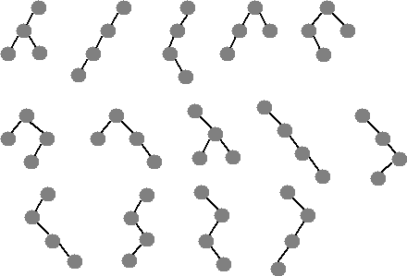
Check Point: Fundamentals
Which one of these is not a binary tree?

Slide 36
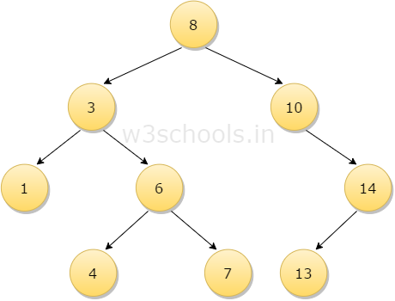
Check Point: Fundamentals
Concepts:
Root = ?
Leaves = ?
Internal nodes = ?
Children of 3 = ?
Siblings of 3 = ?
Parent of 3 = ?
Descendants of 3 = ?
Ancestors of 6 = ?
Subtrees of 3 = ?
Level of 3 = ?
Height of the tree = ?

Slide 37
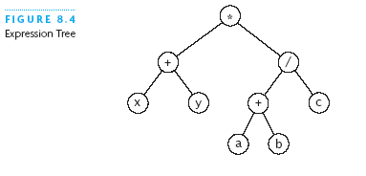
Example: Expression Tree
Each node contains an operator or an operand
Operands are stored in leaf nodes
Parentheses are not stored in the tree because the tree structure dictates the order of operand evaluation
Operators in nodes at higher tree levels are evaluated after operators in nodes at lower tree levels
(x + y) * ((a + b) / c)

Slide 38
Example: Binary Search Tree
dog
Binary search trees
All elements in the left subtree precede those in the right subtree
A formal definition:
A set of nodes T is a binary search tree if either of the following is true:
T is empty
If T is not empty, its root node has two subtrees, T_{L} and T_{R}, such that T_{L} and T_{R} are binary search trees and the value in the root node of T is greater than all values in T_{L} and is less than all values in T_{R}
cat
wolf
canine

Slide 39
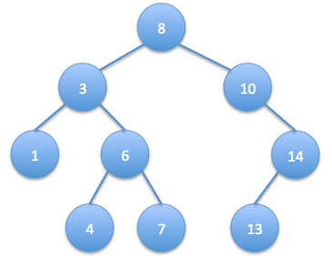
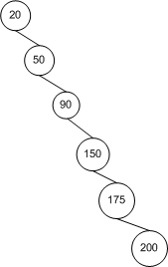
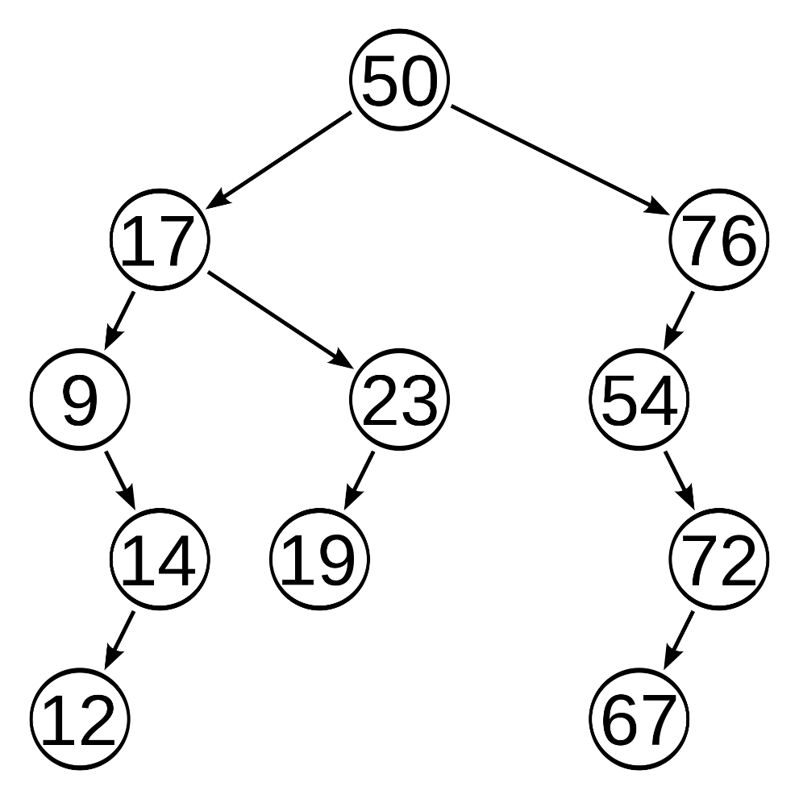
Binary Search Tree Examples

Slide 40
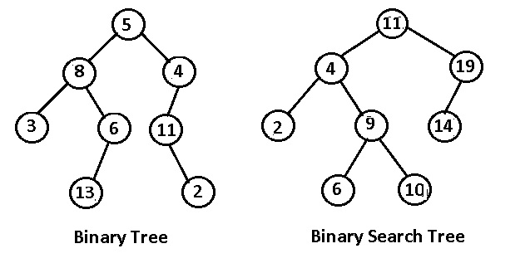
Binary Tree vs. Binary Search Tree

Slide 41
Job Interview Question
Write a function to determine whether a given binary tree of distinct integers is a valid binary search tree.
Direct recursion does not work.

Slide 42
Binary Search Tree (cont.)
A binary search tree never has to be sorted because its elements always satisfy the required order relationships
When new elements are inserted (or removed) properly, the binary search tree maintains its order
In contrast, a sorted array must be expanded whenever new elements are added, and compacted whenever elements are removed—expanding and contracting are both O(n)

Slide 43
Binary Search Tree (cont.)
When searching a BST, each probe has the potential to eliminate half the elements in the tree, so searching can be O(log n)
In the worst case, searching is O(n)

Slide 44
Recursive Algorithm for Searching a Binary Tree
if the tree is empty
return null (target is not found) else if the target matches the root node's data
return the data stored at the root node else if the target is less than the root node's data
return the result of searching the left subtree of the root else
return the result of searching the right subtree of the root

Slide 45
Full, Perfect, and Complete Binary Trees
A full binary tree is a binary tree where all nodes have either 2 children or 0 children (the leaf nodes)
7
1
10
0
3
9
12
2
5
11
13
4
6

Slide 46
Full, Perfect, and Complete Binary Trees (cont.)
A perfect binary tree is a full binary tree of height n with exactly 2^{n} – 1 nodes
In this case, n = 3 and 2^{n} – 1 = 7
3
1
5
0
2
4
6

Slide 47
Full, Perfect, and Complete Binary Trees (cont.)
A complete binary tree is a perfect binary tree through level n - 1 with some extra leaf nodes at level n (the tree height), all toward the left
3
1
5
0
2
4

Slide 48
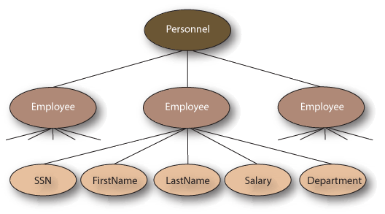
General Trees
We do not discuss general trees in this chapter.

Slide 49
Tree Traversals
Revise your recursion.

Slide 50
Tree Traversals
Often we want to determine the nodes of a tree and their relationship
We can do this by walking through the tree in a prescribed order and visiting the nodes as they are encountered
This process is called tree traversal
Three common kinds of binary tree traversal
Inorder
Preorder
Postorder

Slide 51
Google Interview Question
Write a preorder traversal of a binary search tree without recursion / stack / extra memory storage.
Hint – you can augment the node data structure. However, you can’t add a visited field to the node.
Print a tree like
(Parent ( leftchild (leftchild, rightchild), rightchild(leftchild,rightchild) ) )

Slide 52
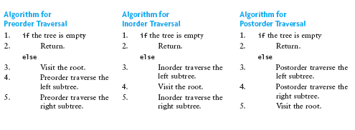
Tree Traversals (cont.)
Preorder: visit root node, traverse T_{L}, traverse T_{R}
Inorder: traverse T_{L}, visit root node, traverse T_{R}
Postorder: traverse T_{L}, traverse T_{R}, visit root node

Slide 53
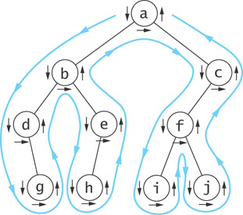
Visualizing Tree Traversals
You can visualize a tree traversal by imagining a mouse that walks along the edge of the tree
If the mouse always keeps the tree to the left, it will trace a route known as the Euler tour
The Euler tour is the path traced in blue in the figure on the right

Slide 54
Visualizing Tree Traversals (cont.)
A Euler tour (blue path) is a preorder traversal
The sequence in this example is a b d g e h c f i j
The mouse visits each node before traversing its subtrees (shown by the downward pointing arrows)

Slide 55
Visualizing Tree Traversals (cont.)
If we record a node as the mouse returns from traversing its left subtree (shown by horizontal black arrows in the figure) we get an inorder traversal
The sequence is d g b h e a i f j c

Slide 56
Visualizing Tree Traversals (cont.)
If we record each node as the mouse last encounters it, we get a postorder traversal (shown by the upward pointing arrows)
The sequence is g d h e b i j f c a

Slide 57
Traversals of Binary Search Trees and Expression Trees
An inorder traversal of a binary search tree results in the nodes being visited in sequence by increasing data value
canine, cat, dog, wolf
dog
cat
wolf
canine

Slide 58
Job Interview Question
Write a function to determine whether a given binary tree of distinct integers is a valid binary search tree.
Direct recursion does not work.

Slide 59
Traversals of Binary Search Trees and Expression Trees (cont.)
An inorder traversal of an expression tree results in the sequence x + y * a + b / c
If we insert parentheses where they belong, we get the infix form:
(x + y) * ((a + b) / c)
*
+
/
x
y
+
c
a
b

Slide 60
Traversals of Binary Search Trees and Expression Trees (cont.)
A postorder traversal of an expression tree results in the sequence x y + a b + c / *
This is the postfix or reverse polish form of the expression
Operators follow operands
*
+
/
x
y
+
c
a
b

Slide 61
Traversals of Binary Search Trees and Expression Trees (cont.)
A preorder traversal of an expression tree results in the sequence * + x y / + a b c
This is the prefix or forward polish form of the expression
Operators precede operands
*
+
/
x
y
+
c
a
b

Slide 62
Implementing a BinaryTree Class

Slide 63
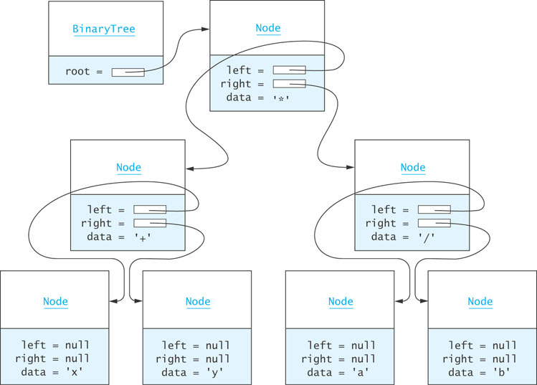
BinaryTree<E> Class (cont.)

Slide 64
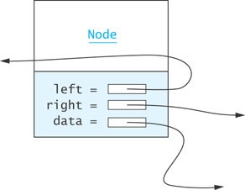
Node<E> Class
Just as for a linked list, a node consists of a data part and links to successor nodes
The data part is a reference to type E
A binary tree node must have links to both its left and right subtrees

Slide 65
Node<E> Class (cont.)
protected static class Node<E> implements Serializable {
protected E data;
protected Node<E> left;
protected Node<E> right;
public Node(E data) {
this.data = data;
left = null;
right = null;
}
public String toString() {
return data.toString();
}
}
Node<E> is declared as an inner class within BinaryTree<E>

Slide 66
Node<E> Class (cont.)
protected static class Node<E> implements Serializable {
protected E data;
protected Node<E> left;
protected Node<E> right;
public Node(E data) {
this.data = data;
left = null;
right = null;
}
public String toString() {
return data.toString();
}
}
Node<E> is declared protected. This way we can use it as a superclass.

Slide 67
BinaryTree<E> Class (cont.)
Assuming the tree is referenced by variable bT (type BinaryTree) then . . .

Slide 68
BinaryTree<E> Class (cont.)
bT.root.data references the Character object storing '*'

Slide 69
BinaryTree<E> Class (cont.)
bT.root.left references the left subtree of the root

Slide 70
BinaryTree<E> Class (cont.)
bT.root.right references the right subtree of the root

Slide 71
BinaryTree<E> Class (cont.)
bT.root.right.data references the Character object storing '/'

Slide 72
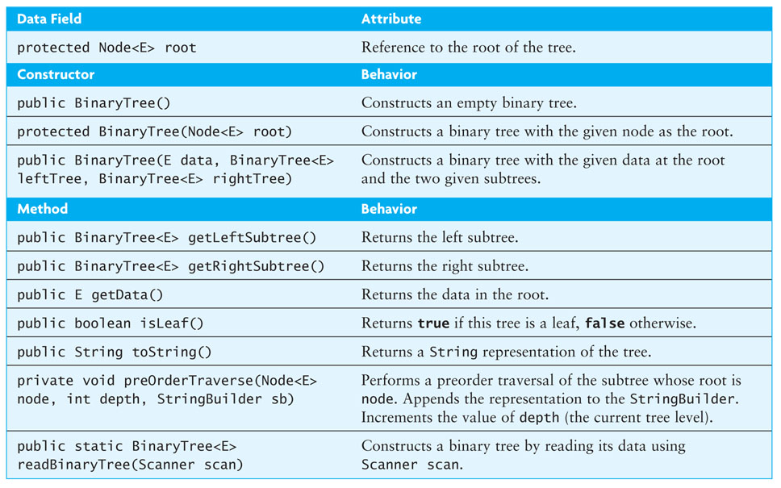
BinaryTree<E> Class (cont.)

Slide 73
BinaryTree<E> Class (cont.)
Class heading and data field declarations:
import java.io.*;
public class BinaryTree<E> implements Serializable {
// Insert inner class Node<E> here
protected Node<E> root;
. . .
}

Slide 74
BinaryTree<E> Class (cont.)
The Serializable interface defines no methods
It provides a marker for classes that can be written to a binary file using the ObjectOutputStream and read using the ObjectInputStream

Slide 75
Constructors
The no-parameter constructor:
public BinaryTree() {
root = null;
}
The constructor that creates a tree with a given node at the root:
protected BinaryTree(Node<E> root) {
this.root = root;
}

Slide 76
Constructors (cont.)
The constructor that builds a tree from a data value and two trees:
public BinaryTree(E data, BinaryTree<E> leftTree,
BinaryTree<E> rightTree) {
root = new Node<E>(data);
if (leftTree != null) {
root.left = leftTree.root;
} else {
root.left = null;
}
if (rightTree != null) {
root.right = rightTree.root;
} else {
root.right = null;
}
}
root.left = leftTree.root;
root.right = rightTree.root;
Replace it with?
protected static class Node<E> implements Serializable {
protected E data;
protected Node<E> left = null;
protected Node<E> right = null;
.
.
.
}

Slide 77
getLeftSubtree and getRightSubtree Methods
public BinaryTree<E> getLeftSubtree() {
if (root != null && root.left != null) {
return new BinaryTree<E>(root.left);
} else {
return null;
}
}
getRightSubtree method is symmetric

Slide 78
isLeaf Method
public boolean isLeaf() {
return (root.left == null && root.right == null);
}

Slide 79
toString Method
The toString method generates a string representing a preorder traversal in which each local root is indented a distance proportional to its depth
public String toString() {
StringBuilder sb = new StringBuilder();
preOrderTraverse(root, 1, sb);
return sb.toString();
}

Slide 80
preOrderTraverse Method
private void preOrderTraverse(Node<E> node, int depth, StringBuilder sb) {
for (int i = 1; i < depth; i++) {
sb.append(" "); // indentation
}
if (node == null) {
sb.append("null\n");
} else {
sb.append(node.toString());
sb.append("\n");
preOrderTraverse(node.left, depth + 1, sb);
preOrderTraverse(node.right, depth + 1, sb);
}
}

Slide 81
preOrderTraverse Method (cont.)
*
+
x
null
null
y
null
null
/
a
null
null
b
null
null
*
+
/
x
y
a
b
(x + y) * (a / b)

Slide 82
Binary Search Trees
Search
Insert
Remove

Slide 83
Overview of a Binary Search Tree
Recall the definition of a binary search tree:
A set of nodes T is a binary search tree if either of the following is true
T is empty
If T is not empty, its root node has two subtrees, T_{L} and T_{R}, such that T_{L} and T_{R} are binary search trees and the value in the root node of T is greater than all values in T_{L} and less than all values in T_{R}

Slide 84
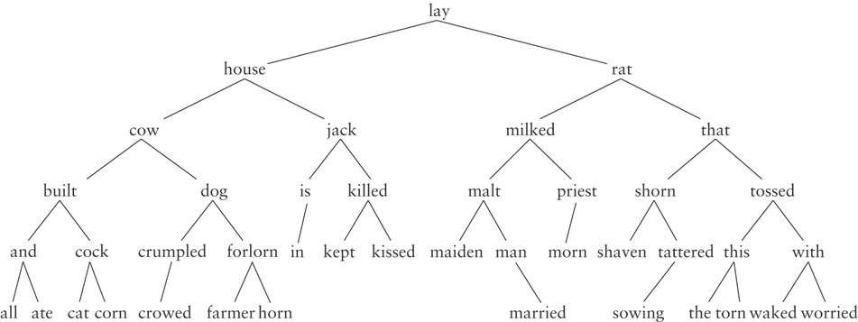
Overview of a Binary Search Tree (cont.)

Slide 85
Recursive Algorithm for Searching a Binary Search Tree
if the root is null
the item is not in the tree; return null
Compare the value of target with root.data
if they are equal
the target has been found; return the data at the root
else if the target is less than root.data
return the result of searching the left subtree
else
return the result of searching the right subtree

Slide 86
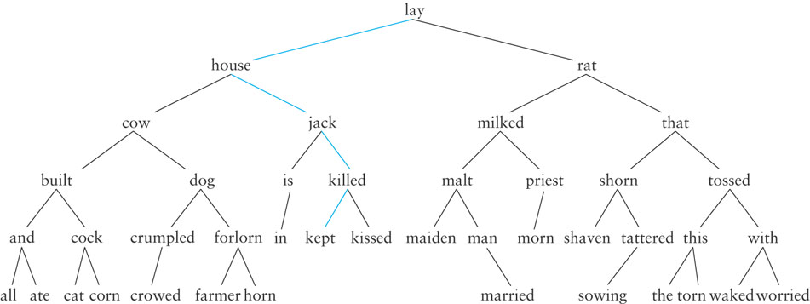
Searching a Binary Tree
Searching for "kept"

Slide 87
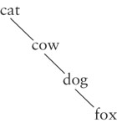
Performance
Search a tree is generally O(log n)
If a tree is not very full, performance will be worse
Searching a tree with only right subtrees, for example, is O(n)

Slide 88
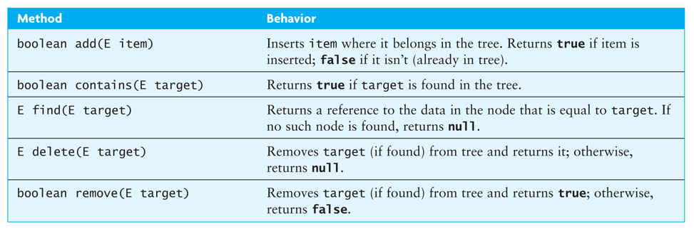
Interface SearchTree<E>

Slide 89
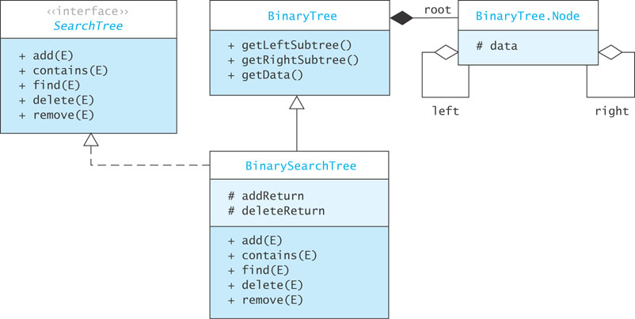
BinarySearchTree<E> Class

Slide 90
Implementing find Methods

Slide 91
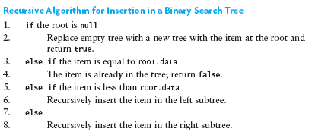
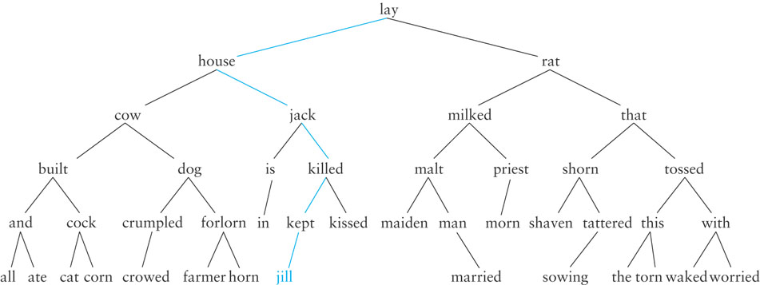
Insertion into a Binary Search Tree

Slide 92
Implementing the add Methods
/** Starter method add.
pre: The object to insert must implement the
Comparable interface.
@param item The object being inserted
@return true if the object is inserted, false
if the object already exists in the tree
*/
public boolean add(E item) {
root = add(root, item);
return addReturn;
}

Slide 93
Implementing the add Methods (cont.)
/** Recursive add method.
post: The data field addReturn is set true if the item is added to
the tree, false if the item is already in the tree.
@param localRoot The local root of the subtree
@param item The object to be inserted
@return The new local root that now contains the
inserted item
*/
private Node<E> add(Node<E> localRoot, E item) {
if (localRoot == null) {
// item is not in the tree — insert it.
addReturn = true;
return new Node<E>(item);
} else if (item.compareTo(localRoot.data) == 0) {
// item is equal to localRoot.data
addReturn = false;
return localRoot;
} else if (item.compareTo(localRoot.data) < 0) {
// item is less than localRoot.data
localRoot.left = add(localRoot.left, item);
return localRoot;
} else {
// item is greater than localRoot.data
localRoot.right = add(localRoot.right, item);
return localRoot;
}
}

Slide 94
Removal from a Binary Search Tree
Let R be the node to be removed
Three cases need to be considered:
R is Leaf – R has no children then
simply delete R
R is an Internal Node:
R has one child
Changes: make R’s parent reference R’s only child
R has two children
Requires a bit more work…

Slide 95
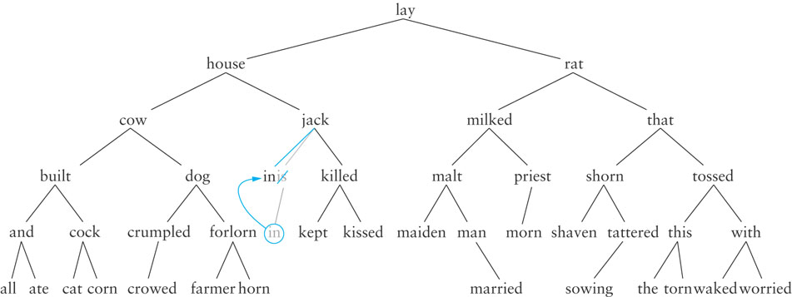
Removal from a Binary Search Tree: One-Child Case

Slide 96
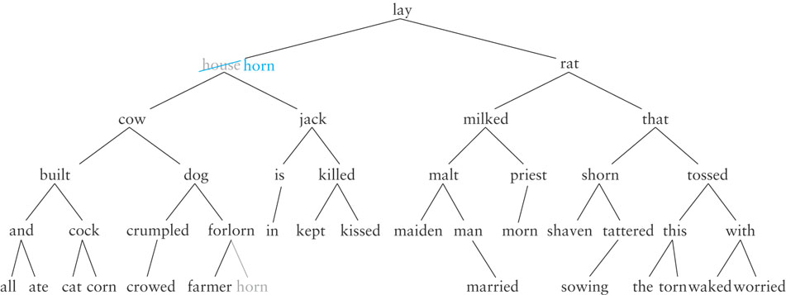
Removing from a Binary Search Tree Two Children Case
If the item (value) to be removed has two children, then
Replace it with the largest item in its left subtree
the inorder predecessor
Delete the node with the largest value from its left subtree

Slide 97
Removing from a Binary Search Tree Two Children Case (tricky instance)
Delete rat

Slide 98
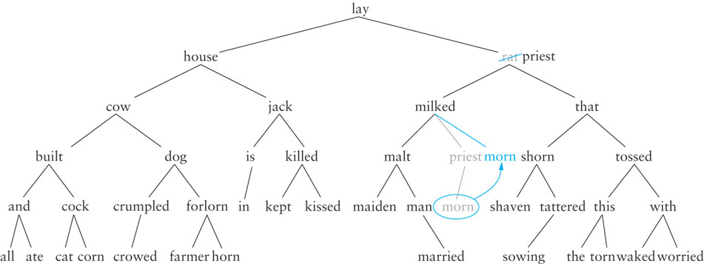
Removing from a Binary Search Tree Two Children Case (tricky instance)
Need to solve a One-Child case!
→
Recursion?

Slide 99
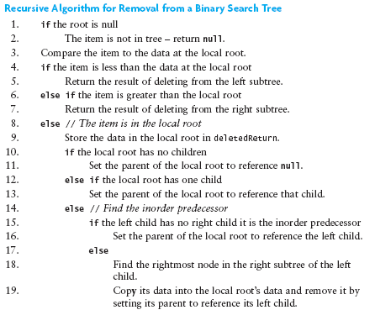
Algorithm for Removing from a Binary Search Tree

Slide 100
Implementing the delete Method
Listing 6.5 (BinarySearchTree delete Methods; pages 325-326)
NOTE:
There is nothing special about the left subtree. We could do the same thing with the right subtree.
How?
Just use the smallest value in the right subtree.

Slide 101
Testing a Binary Search Tree
Verify that an inorder traversal will display the tree contents in ascending order after a series of insertions and deletions are performed

Slide 102
Job Interview Questions - Revisit
First explain what a tree, then binary tree, then a binary search tree is. Implement a function that verifies whether a binary tree is a valid binary search tree.
Find the deepest common ancestor of two nodes in a tree structure.
Define binary search tree. Develop a procedure to verify a binary search tree.
Find the height of a binary tree
Find the max depth of a binary tree
Write a function that takes 2 arguments: a binary tree and an integer n, it should return the n-th element in the inorder traversal of the binary tree.

Slide 103
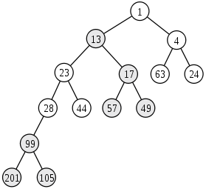
Job Interview Questions
Convert a binary search tree to a sorted double-linked list. We can only change the target of pointers, but cannot create any new nodes.
Write an algorithm to travere a binary tree level wise.

Slide 104
Heaps and Priority Queues

Slide 105
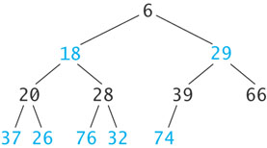
Heaps and Priority Queues
A heap is a complete binary tree with the following properties
The value in the root is the smallest item in the tree
Every nonempty subtree is
a heap
Recursive definition

Slide 106
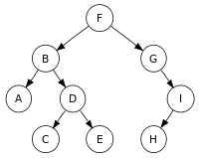
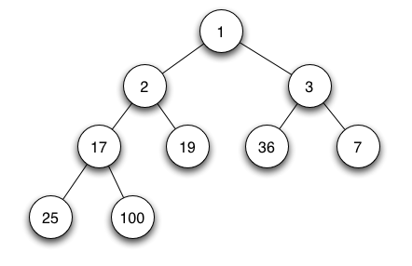
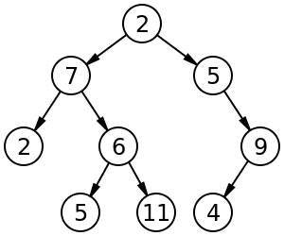
Which one these are heaps?
27
28
29
33
30
39
66
Max-heap
37
26
76
32
74

Slide 107
Inserting an Item into a Heap
6
18
29
20
28
39
66
37
26
76
32
74
89

Slide 108
Inserting an Item into a Heap (cont.)
6
18
29
20
28
39
66
37
26
76
32
74
89
8

Slide 109
Inserting an Item into a Heap (cont.)
6
18
29
20
28
39
8
37
26
76
32
74
89
66

Slide 110
Inserting an Item into a Heap (cont.)
6
18
8
20
28
39
29
37
26
76
32
74
89
66

Slide 111
Inserting an Item into a Heap (cont.)
6
18
8
20
28
39
29
37
26
76
32
74
89
66

Slide 112
Removing an Item from a Heap
Always remove from the root
6
18
8
20
28
39
29
37
26
76
32
74
89
66

Slide 113
Removing an Item from a Heap (cont.)
6
18
8
20
28
39
29
37
26
76
32
74
89
66

Slide 114
Removing an Item from a Heap (cont.)
66
18
8
20
28
39
29
37
26
76
32
74
89

Slide 115
Removing an Item from a Heap (cont.)
8
18
66
20
28
39
29
37
26
76
32
74
89

Slide 116
Removing an Item from a Heap (cont.)
8
18
29
20
28
39
66
37
26
76
32
74
89

Slide 117
Removing an Item from a Heap (cont.)
8
18
29
20
28
39
66
37
26
76
32
74
89

Slide 118
Implementing a Heap
Because a heap is a complete binary tree, it can be implemented efficiently using an array rather than a linked data structure

Slide 119
Implementing a Heap (cont.)
8
8
29
18
29
18
39
66
20
66
20
28
28
39
37
37
26
26
76
76
32
32
74
74
89
89
0
1
2
3
4
5
6
7
8
9
10
11
12
8
18
29
20
28
39
66
37
26
76
32
74
89

Slide 120
Implementing a Heap (cont.)
For a node at position p, L. child position: 2p + 1
R. child position: 2p + 2
8
18
29
20
28
39
66
37
26
76
32
74
89
0
1
2
3
4
5
6
7
8
9
10
11
12
8
18
29
20
28
39
66
37
26
76
32
74
89
Parent
L. Child
R. Child

Slide 121
Implementing a Heap (cont.)
For a node at position p, L. child position: 2p + 1
R. child position: 2p + 2
8
18
29
20
28
39
66
37
26
76
32
74
89
0
1
2
3
4
5
6
7
8
9
10
11
12
8
18
29
20
28
39
66
37
26
76
32
74
89
Parent
L. Child
R. Child

Slide 122
Implementing a Heap (cont.)
For a node at position p, L. child position: 2p + 1
R. child position: 2p + 2
8
18
29
20
28
39
66
37
26
76
32
74
89
0
1
2
3
4
5
6
7
8
9
10
11
12
8
18
29
20
28
39
66
37
26
76
32
74
89
Parent
L. Child
R. Child

Slide 123
Implementing a Heap (cont.)
For a node at position p, L. child position: 2p + 1
R. child position: 2p + 2
8
18
29
20
28
39
66
37
26
76
32
74
89
0
1
2
3
4
5
6
7
8
9
10
11
12
8
18
29
20
28
39
66
37
26
76
32
74
89
Parent
L. Child
R. Child

Slide 124
Implementing a Heap (cont.)
For a node at position p, L. child position: 2p + 1
R. child position: 2p + 2
8
18
29
20
28
39
66
37
26
76
32
74
89
0
1
2
3
4
5
6
7
8
9
10
11
12
8
18
29
20
28
39
66
37
26
76
32
74
89
Parent
L. Child
R. Child

Slide 125
Implementing a Heap (cont.)
8
18
29
A node at position c can find its parent at (c – 1)/2
20
28
39
66
37
26
76
32
74
89
0
1
2
3
4
5
6
7
8
9
10
11
12
8
18
29
20
28
39
66
37
26
76
32
74
89
Parent
Child

Slide 126
Inserting into a Heap Implemented as an ArrayList
1. Insert the new element at the end of the ArrayList and set child to table.size() - 1
8
18
29
20
28
39
66
37
26
76
32
74
89
0
1
2
3
4
5
6
7
8
9
10
11
12
13
8
18
29
20
28
39
66
37
26
76
32
74
89

Slide 127
Inserting into a Heap Implemented as an ArrayList (cont.)
1. Insert the new element at the end of the ArrayList and set child to table.size() - 1
6
18
29
20
28
39
66
37
26
76
32
74
89
8
0
1
2
3
4
5
6
7
8
9
10
11
12
13
6
18
29
20
28
39
66
37
26
76
32
74
89
8
Child

Slide 128
Inserting into a Heap Implemented as an ArrayList (cont.)
2. Set parent to (child – 1)/ 2
6
18
29
20
28
39
66
37
26
76
32
74
89
8
0
1
2
3
4
5
6
7
8
9
10
11
12
13
6
18
29
20
28
39
66
37
26
76
32
74
89
8
Parent
Child

Slide 129
Inserting into a Heap Implemented as an ArrayList (cont.)
3. while (parent >= 0 and table[parent] > table[child])
Swap table[parent] and table[child]
Set child equal to parent
Set parent equal to (child-1)/2
6
18
29
20
28
39
66
37
26
76
32
74
89
8
0
1
2
3
4
5
6
7
8
9
10
11
12
13
6
18
29
20
28
39
66
37
26
76
32
74
89
8
Parent
Child

Slide 130
Inserting into a Heap Implemented as an ArrayList (cont.)
3. while (parent >= 0 and table[parent] > table[child])
Swap table[parent] and table[child]
Set child equal to parent
Set parent equal to (child-1)/2
6
18
29
20
28
39
8
37
26
76
32
74
89
66
0
1
2
3
4
5
6
7
8
9
10
11
12
13
6
18
29
20
28
39
8
37
26
76
32
74
89
66
Parent
Child

Slide 131
Inserting into a Heap Implemented as an ArrayList (cont.)
3. while (parent >= 0 and table[parent] > table[child])
Swap table[parent] and table[child]
Set child equal to parent
Set parent equal to (child-1)/2
6
18
29
20
28
39
8
37
26
76
32
74
89
66
0
1
2
3
4
5
6
7
8
9
10
11
12
13
6
18
29
20
28
39
8
37
26
76
32
74
89
66
Parent
Child

Slide 132
Inserting into a Heap Implemented as an ArrayList (cont.)
3. while (parent >= 0 and table[parent] > table[child])
Swap table[parent] and table[child]
Set child equal to parent
Set parent equal to (child-1)/2
6
18
29
20
28
39
8
37
26
76
32
74
89
66
0
1
2
3
4
5
6
7
8
9
10
11
12
13
6
18
29
20
28
39
8
37
26
76
32
74
89
66
Parent
Child

Slide 133
Inserting into a Heap Implemented as an ArrayList (cont.)
3. while (parent >= 0 and table[parent] > table[child])
Swap table[parent] and table[child]
Set child equal to parent
Set parent equal to (child-1)/2
6
18
29
20
28
39
8
37
26
76
32
74
89
66
0
1
2
3
4
5
6
7
8
9
10
11
12
13
6
18
29
20
28
39
8
37
26
76
32
74
89
66
Parent
Child

Slide 134
Inserting into a Heap Implemented as an ArrayList (cont.)
3. while (parent >= 0 and table[parent] > table[child])
Swap table[parent] and table[child]
Set child equal to parent
Set parent equal to (child-1)/2
6
18
8
20
28
39
29
37
26
76
32
74
89
66
0
1
2
3
4
5
6
7
8
9
10
11
12
13
6
18
8
20
28
39
29
37
26
76
32
74
89
66
Parent
Child

Slide 135
Inserting into a Heap Implemented as an ArrayList (cont.)
3. while (parent >= 0 and table[parent] > table[child])
Swap table[parent] and table[child]
Set child equal to parent
Set parent equal to (child-1)/2
6
18
8
20
28
39
29
37
26
76
32
74
89
66
0
1
2
3
4
5
6
7
8
9
10
11
12
13
6
18
8
20
28
39
29
37
26
76
32
74
89
66
Parent
Child

Slide 136
Inserting into a Heap Implemented as an ArrayList (cont.)
3. while (parent >= 0 and table[parent] > table[child])
Swap table[parent] and table[child]
Set child equal to parent
Set parent equal to (child-1)/2
6
18
8
20
28
39
29
37
26
76
32
74
89
66
0
1
2
3
4
5
6
7
8
9
10
11
12
13
6
18
8
20
28
39
29
37
26
76
32
74
89
66
Parent
Child

Slide 137
Inserting into a Heap Implemented as an ArrayList (cont.)
3. while (parent >= 0 and table[parent] > table[child])
Swap table[parent] and table[child]
Set child equal to parent
Set parent equal to (child-1)/2
6
18
8
20
28
39
29
37
26
76
32
74
89
66
0
1
2
3
4
5
6
7
8
9
10
11
12
13
6
18
8
20
28
39
29
37
26
76
32
74
89
66

Slide 138
Removal from a Heap Implemented as an ArrayList
Removing an Element from a Heap Implemented as an ArrayList
1. Remove the last element (i.e., the one at size() – 1) and set the item at 0 to this value.
2. Set parent to 0.
3. while (true)
4. Set leftChild to (2 * parent) + 1 and rightChild to leftChild + 1.
5. if leftChild >= table.size()
6. Break out of loop.
7. Assume minChild (the smaller child) is leftChild.
8. if rightChild < table.size() and
table[rightChild] < table[leftChild]
9. Set minChild to rightChild.
10. if table[parent] > table[minChild]
11. Swap table[parent] and table[minChild].
12. Set parent to minChild.
else
13. Break out of loop.

Slide 139
Performance of the Heap
remove traces a path from the root to a leaf
insert traces a path from a leaf to the root
This requires at most h steps where h is the height of the tree
The largest full tree of height h has 2^{h}-1 nodes
The smallest complete tree of height h has 2^{(h-1)} nodes
Both insert and remove are O(log n)

Slide 140
Job Interview Questions
Given an array 1 to N, how many permutations of it will be Min Heap.
This is pretty tricky…
Recall palindromes?
Find numbers which are palindromic in both their decimal and octal representations

Slide 141
Priority Queues
The heap is used to implement a special kind of queue called a priority queue
The heap is not very useful as an ADT on its own
We will not create a Heap interface or code a class that implements it
Instead, we will incorporate its algorithms when we implement a priority queue class and heapsort
Sometimes a FIFO queue may not be the best way to implement a waiting line
A priority queue is a data structure in which only the highest-priority item is accessible

Slide 142
Priority Queues (cont.)
In a print queue, sometimes it is more appropriate to print a short document that arrived after a very long document
A priority queue is a data structure in which only the highest-priority item is accessible (as opposed to the first item entered)

Slide 143
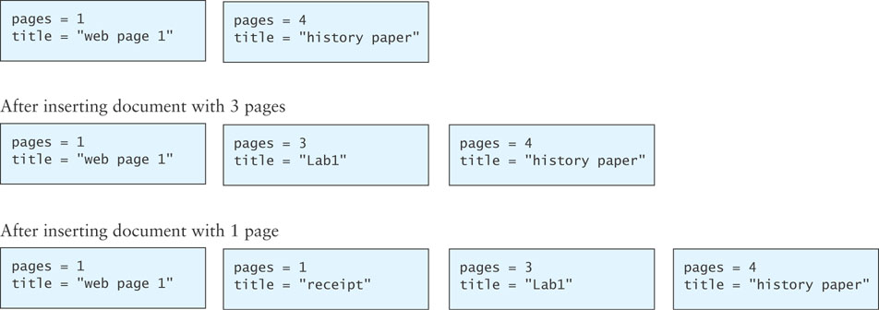
Insertion into a Priority Queue
Priority of document is inversely proportional to its page count.

Slide 144
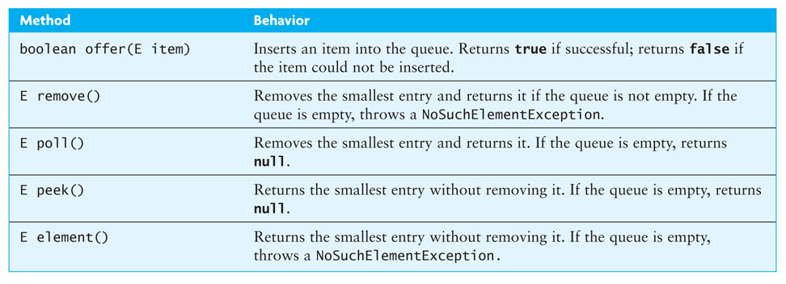
PriorityQueue Class
Java provides a PriorityQueue<E> class that implements the Queue<E> interface given in Chapter 4.

Slide 145
Using a Heap as the Basis of a Priority Queue
In a priority queue, just like a heap, the “smallest” item always is removed first
Because heap insertion and removal is O(log n), a heap can be the basis of a very efficient implementation of a priority queue
java.util.PriorityQueue uses an Object[] array.
The TA will present an implementation of priority queue using an ArrayList

Slide 146
Huffman Trees

Slide 147
Huffman Tree
A Huffman tree represents Huffman codes for characters that might appear in a text file
As opposed to ASCII or Unicode, Huffman code uses different numbers of bits to encode letters
more common characters use fewer bits
Examples of frequently used characters are…
Many programs that compress files use Huffman codes

Slide 148
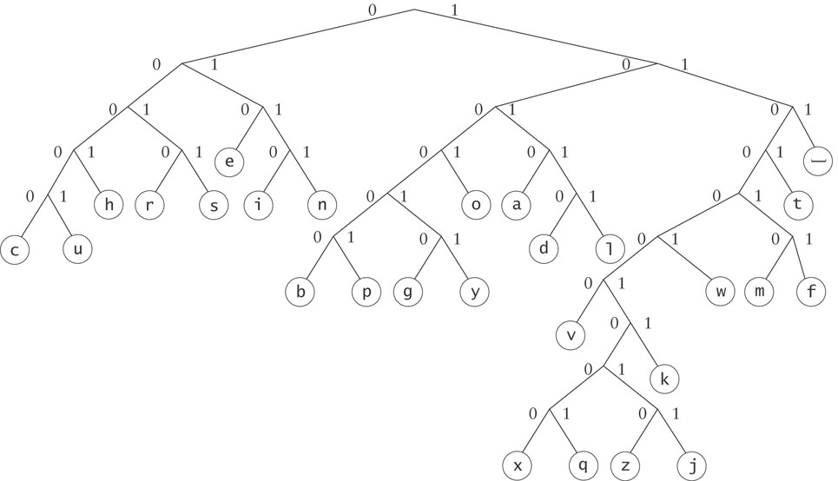
Huffman Tree (cont.)
To form a code, traverse the tree from the root to the chosen character, appending 0 if you branch left, and 1 if you branch right.

Slide 149
Huffman Tree (cont.)
Examples:
d : 10110
e : 010

Slide 150
Huffman Trees
A Huffman tree can be implemented using a binary tree and a PriorityQueue
A straight binary encoding of an alphabet assigns a unique binary number to each symbol in the alphabet
Unicode is an example of such a coding
The message “go eagles” requires 144 bits in Unicode but only 38 bits using Huffman coding

Slide 151
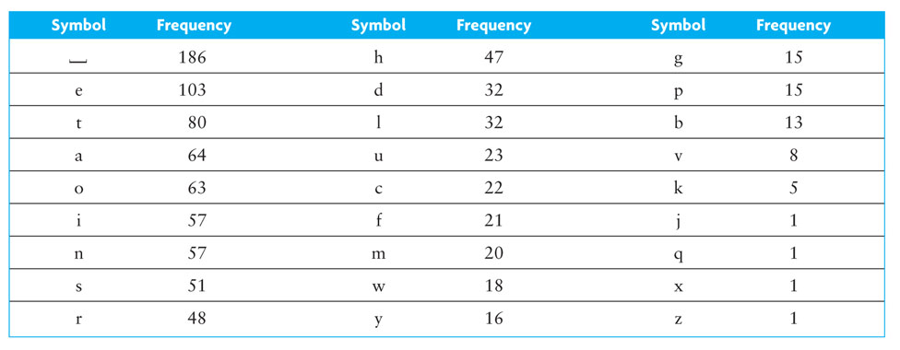
Huffman Trees (cont.)

Slide 152
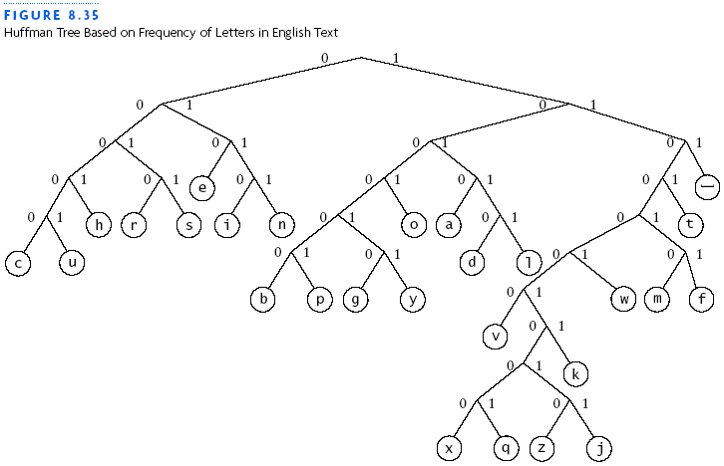
Huffman Trees (cont.)

Slide 153
Building a Custom Huffman Tree
Suppose we want to build a custom Huffman tree for a file
Input: an array of objects such that each object contains a reference to a symbol occurring in that file and the frequency of occurrence (weight) for the symbol in that file

Slide 154
Building a Custom Huffman Tree (cont.)
Analysis:
Each node will have storage for two data items:
the weight of the node and
the symbol associated with the node
All symbols will be stored in leaf nodes
For nodes that are not leaf nodes, the symbol part has no meaning
The weight of a leaf node will be the frequency of the symbol stored at that node
The weight of an interior node will be the sum of frequencies of all leaf nodes in the subtree rooted at the interior node

Slide 155
Building a Custom Huffman Tree (cont.)
Analysis:
A priority queue will be the key data structure in our Huffman tree
We will store individual symbols and subtrees of multiple symbols in order by their priority (frequency of occurrence)

Slide 156
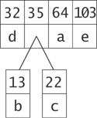
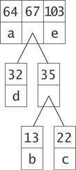
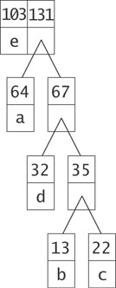
Building a Custom Huffman Tree The Intuition

Slide 157
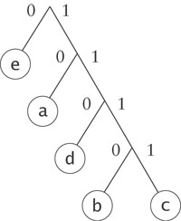
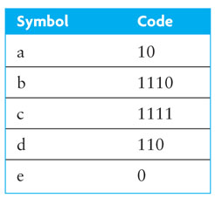
Building a Custom Huffman Tree (cont.)

Slide 158
Design
Algorithm for Building a Huffman Tree
1. Construct a set of trees with root nodes that contain each of the individual
symbols and their weights.
2. Place the set of trees into a priority queue.
3. while the priority queue has more than one item
4. Remove the two trees with the smallest weights.
5. Combine them into a new binary tree in which the weight of the tree
root is the sum of the weights of its children.
6. Insert the newly created tree back into the priority queue.

Slide 159
Implementation
Listing 6.9 (Class HuffmanTree; page 349)
Listing 6.10 (The buildTree Method (HuffmanTree.java); pages 350-351)
Listing 6.11 (The decode Method (HuffmanTree.java); page 352)

Slide 160
Job Interview Questions
Write code for Huffman encoding.
Nailed it!

Slide 161
Huffman Code Construction: 2nd Example
Char
Freq
E
125
Character count in text.
T
93
A
80
O
76
I
73
N
71
S
65
R
61
H
55
L
41
D
40
C
31
U
27
Example source:
pages.cs.wisc.edu/~shuchi/courses/577-F12/demos/huffman.ppt‎

Slide 162
Huffman Code Construction
Char
Freq
E
125
T
93
A
80
O
76
I
73
N
71
S
65
R
61
H
55
L
41
D
40
C
31
U
27
C
U
31
27

Slide 163
Huffman Code Construction
Char
Freq
E
125
T
93
A
80
O
76
I
73
N
71
S
65
R
61
58
H
55
L
41
D
40
C
31
U
27
58
C
U
31
27

Slide 164
Huffman Code Construction
Char
Freq
E
125
T
93
81
A
80
O
76
I
73
N
71
S
65
R
61
58
H
55
L
41
D
40
81
D
L
40
41
58
C
U
31
27

Slide 165
Huffman Code Construction
Char
Freq
E
125
113
T
93
81
A
80
O
76
I
73
N
71
S
65
R
61
58
H
55
81
113
D
L
H
40
41
58
55
C
U
31
27

Slide 166
Huffman Code Construction
Char
Freq
126
E
125
113
T
93
81
A
80
O
76
I
73
N
71
S
65
R
61
81
126
113
D
L
R
S
H
40
41
61
65
58
55
C
U
31
27

Slide 167
Huffman Code Construction
Char
Freq
144
126
E
125
113
T
93
81
A
80
O
76
I
73
N
71
81
126
144
113
D
L
R
S
N
I
H
40
41
61
65
71
73
58
55
C
U
31
27

Slide 168
Huffman Code Construction
Char
Freq
156
144
126
E
125
113
T
93
81
A
80
O
76
156
A
O
80
76
81
126
144
113
D
L
R
S
N
I
H
40
41
61
65
71
73
58
55
C
U
31
27

Slide 169
Huffman Code Construction
Char
Freq
174
156
144
126
E
125
113
T
93
81
156
174
A
O
T
80
76
81
93
126
144
113
D
L
R
S
N
I
H
40
41
61
65
71
73
58
55
C
U
31
27

Slide 170
Huffman Code Construction
Char
Freq
238
174
156
144
126
E
125
113
156
174
238
A
O
T
E
80
76
81
93
126
144
125
113
D
L
R
S
N
I
H
40
41
61
65
71
73
58
55
C
U
31
27

Slide 171
Huffman Code Construction
Char
Freq
270
238
174
156
144
126
156
174
270
238
A
O
T
E
80
76
81
93
126
144
125
113
D
L
R
S
N
I
H
40
41
61
65
71
73
58
55
C
U
31
27

Slide 172
Huffman Code Construction
Char
Freq
330
270
238
174
156
330
156
174
270
238
A
O
T
E
80
76
81
93
126
144
125
113
D
L
R
S
N
I
H
40
41
61
65
71
73
58
55
C
U
31
27

Slide 173
Huffman Code Construction
Char
Freq
508
330
270
238
330
508
156
174
270
238
A
O
T
E
80
76
81
93
126
144
125
113
D
L
R
S
N
I
H
40
41
61
65
71
73
58
55
C
U
31
27

Slide 174
Huffman Code Construction
Char
Freq
838
508
330
838
330
508
156
174
270
238
A
O
T
E
80
76
81
93
126
144
125
113
D
L
R
S
N
I
H
40
41
61
65
71
73
58
55
C
U
31
27

Slide 175
Huffman Code Construction
0
Char
Freq
Fixed
Huff
1
E
125
0000
110
T
93
0001
011
0
1
A
80
0010
000
0
1
O
76
0011
001
I
73
0100
1011
0
1
0
1
0
N
1
0
1
71
0101
1010
S
65
0110
1001
A
O
T
R
61
E
0111
1000
0
1
0
1
0
1
0
1
H
55
1000
1111
L
41
1001
0101
D
L
R
S
N
I
H
D
40
1010
0100
0
1
C
31
1011
11100
U
27
1100
11101
C
U
Total
838
4.00
3.62

Slide 176
Google Interview Question
Describe a chicken using a programming language.

